Slide 1

MACHINE LEARNING FOR PARTICLE IDENTIFICATION & DEEP GENERATIVE MODELS TOWARDS FAST SIMULATIONS FOR THE ALICE TRD AT CERN
Christiaan Gerhardus Viljoen
MSc Data Science - University of Cape Town

Slide 2
MACHINE LEARNING FOR PARTICLE IDENTIFICATION & DEEP GENERATIVE MODELS TOWARDS FAST SIMULATIONS FOR THE ALICE TRD AT CERN
Christiaan Gerhardus Viljoen
MSc Data Science - University of Cape Town

Slide 3








MACHINE LEARNING FOR PARTICLE IDENTIFICATION & DEEP GENERATIVE MODELS TOWARDS FAST SIMULATIONS FOR THE ALICE TRD AT CERN
$$x$$
$$y$$
$$\hat{y}$$
$$x$$
$$x$$
$$z$$
$$x′$$

Slide 4
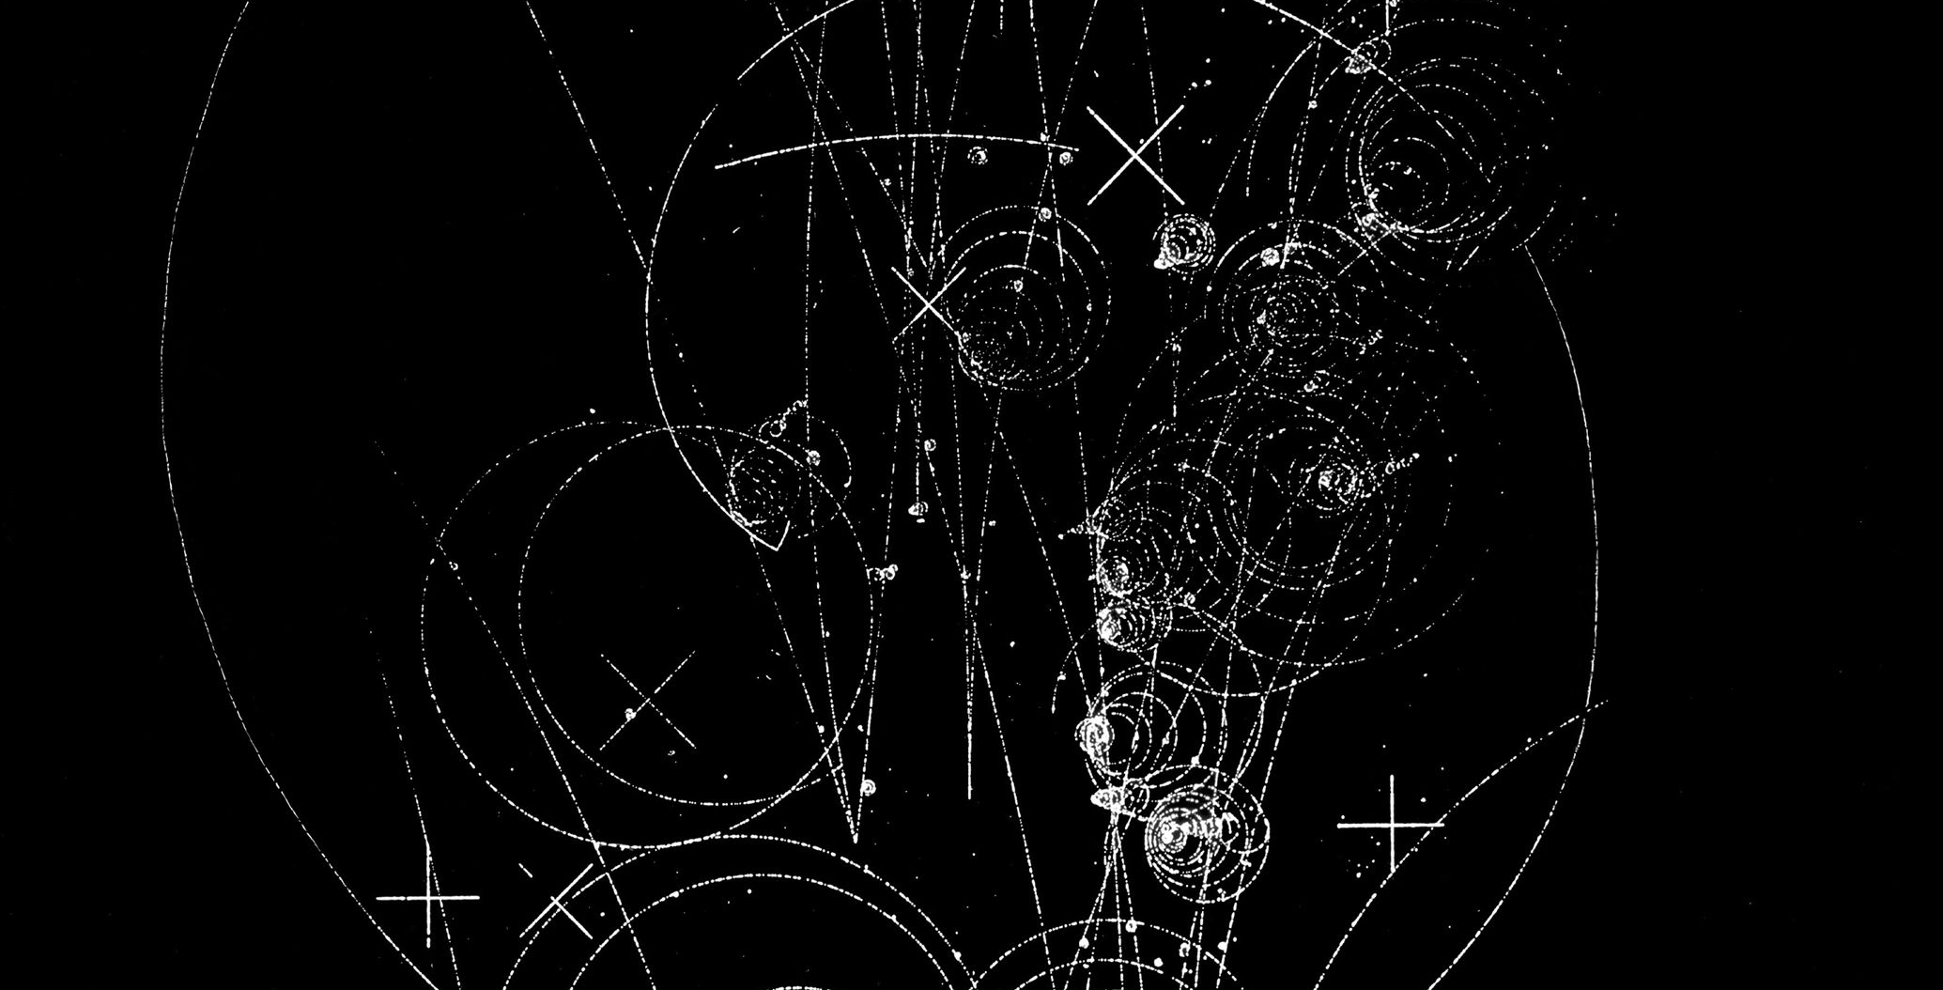
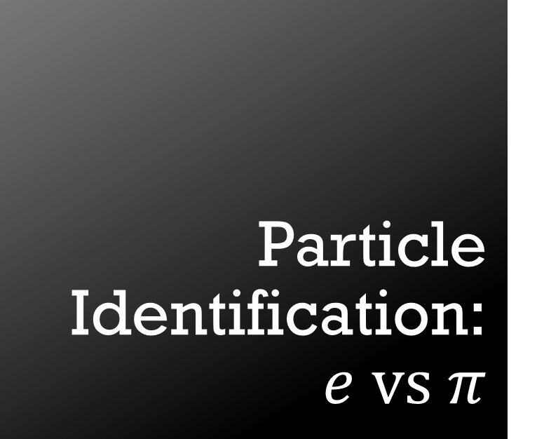
Particle Identification:$e vs π$
USING UNCALIBRATED TRD DIGITS DATA
IMAGES: 17 PADS X 24 TIMEBINS

Slide 5
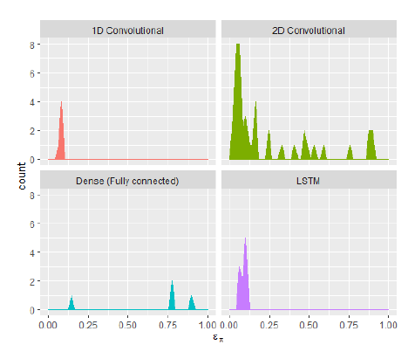
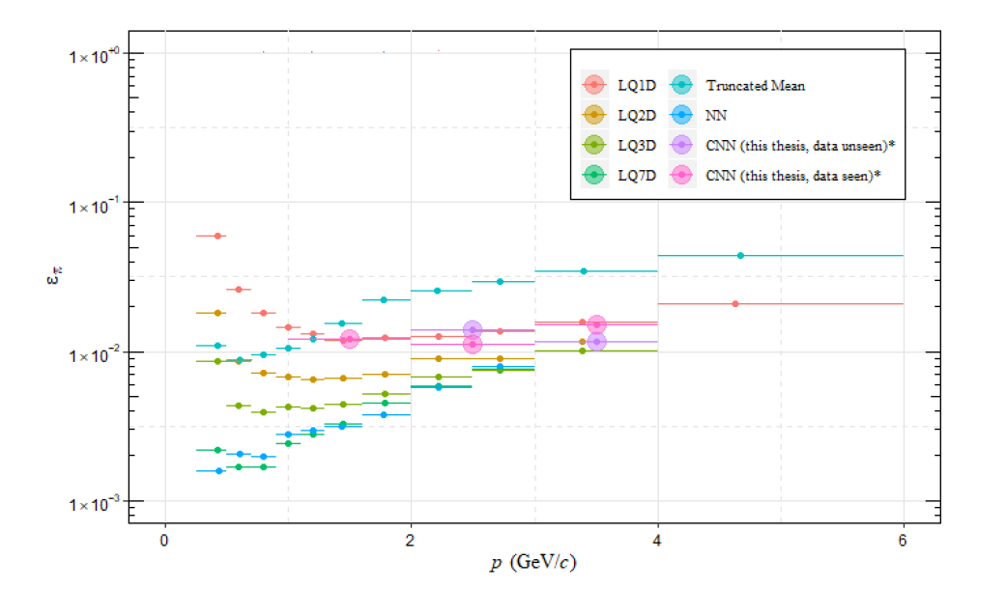
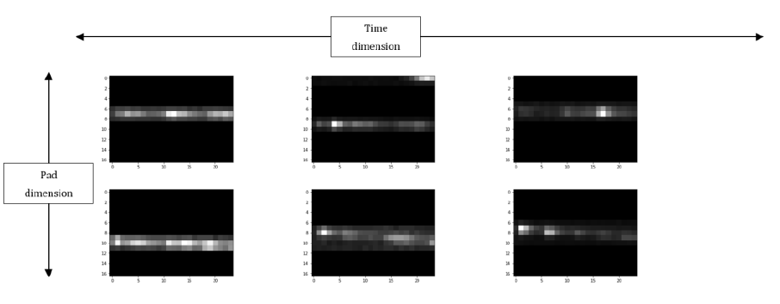




Particle Identification: $e vs π$
$$ε_{π}=6.55\%$$
$$ε_{π}=2.20\%$$
$$ε_{π}=14.86\%$$
$$ε_{π}=5.30\%$$

Slide 6
Monte Carlo vs Real Data
Geant4 simulations: pions configured with environmental parameters from LHCq16/000265343
Assessed against real TRD data from pions:
LHCq16/000265343

Slide 8
Deep Generative Models for Fast Detector Simulations
Variational Autoencoders (VAEs)
Generative Adversarial Networks (GANs)
Adversarial Autoencoders (AAEs)

Slide 9
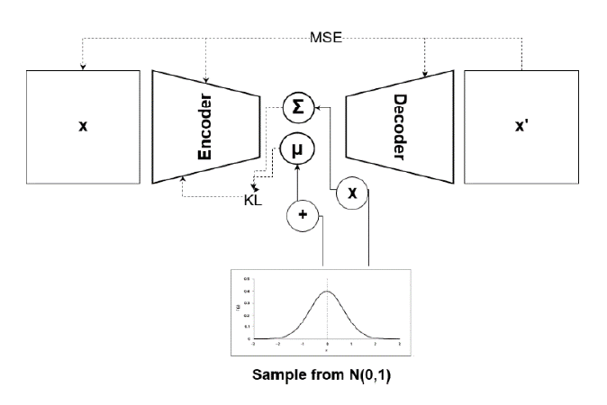
Variational Autoencoders

Slide 10
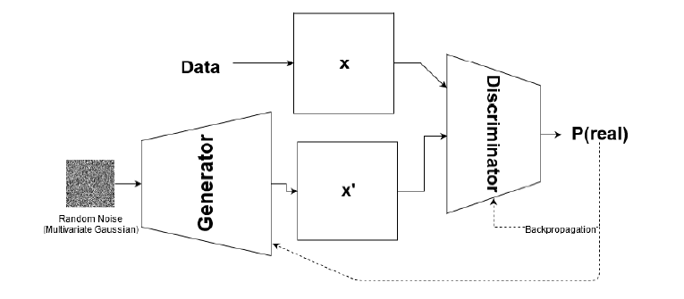
Generative Adversarial Networks

Slide 11
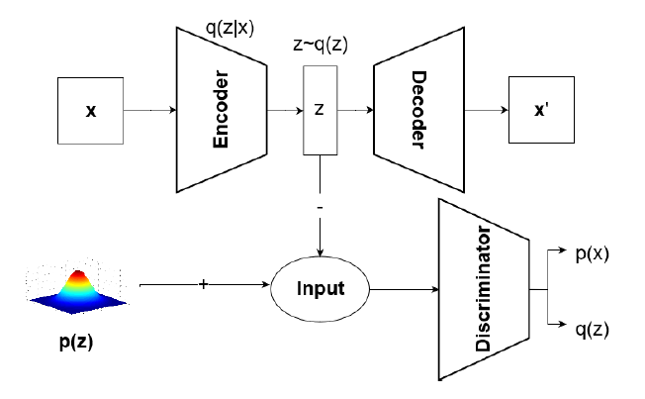
Adversarial Autoencoders

Slide 12
Conclusions
PID with CNNs:
caveat: uncalibrated raw data
reasonable performance
data/MC discrimination with CNNs
very easy to discriminate data from MC with CNNs
possibility to use CNNs for tuning of MC
further work needed
generative models
difficult to train, but high potential for fast simulation
promising first results

